Slide 1
Chapter 8: Main Memory

Slide 2
Chapter 8: Memory Management
Background
Swapping
Contiguous Memory Allocation
Paging
Structure of the Page Table
Segmentation
Example: The Intel Pentium

Slide 3
Objectives
To provide a detailed description of various ways of organizing memory hardware
To discuss various memory-management techniques, including paging and segmentation
To provide a detailed description of the Intel Pentium, which supports both pure segmentation and segmentation with paging

Slide 4
Background
Program must be brought (from disk) into memory and placed within a process for it to be run
Main memory and registers are only storage CPU can access directly
Register access in one CPU clock (or less)
Main memory can take many cycles
Cache sits between main memory and CPU registers
Protection of memory required to ensure correct operation

Slide 5
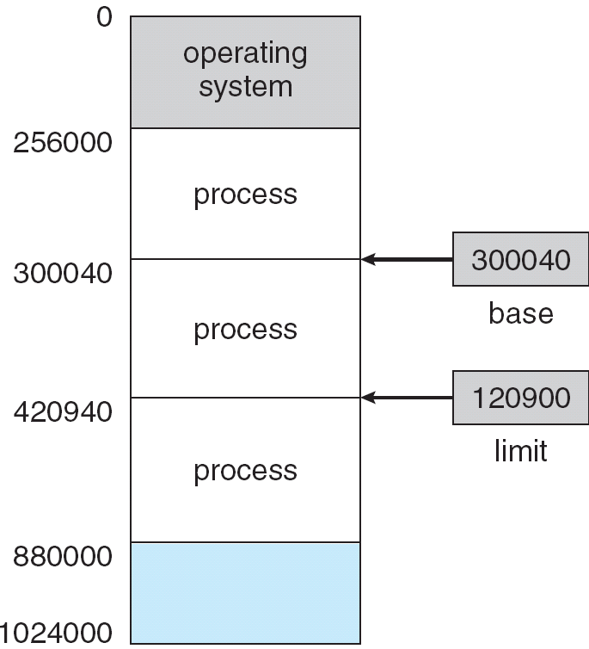
Base and Limit Registers
A pair of base and limit registers define the logical address space

Slide 6
Binding of Instructions and Data to Memory
Address binding of instructions and data to memory addresses can happen at three different stages
  Compile time: If memory location known a priori, absolute code can be generated; must recompile code if starting location changes
  Load time: Must generate relocatable code if memory location is not known at compile time
  Execution time: Binding delayed until run time if the process can be moved during its execution from one memory segment to another. Need hardware support for address maps (e.g., base and limit registers)

Slide 7
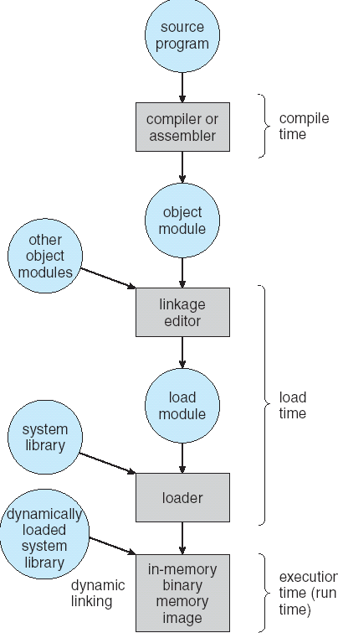
Multistep Processing of a User Program

Slide 8
Logical vs. Physical Address Space
The concept of a logical address space that is bound to a separate physical address space is central to proper memory management
  Logical address – generated by the CPU; also referred to as virtual address
  Physical address – address seen by the memory unit
Logical and physical addresses are the same in compile-time and load-time address-binding schemes; logical (virtual) and physical addresses differ in execution-time address-binding scheme

Slide 9
Memory-Management Unit (MMU)
Hardware device that maps virtual to physical address
In MMU scheme, the value in the relocation register is added to every address generated by a user process at the time it is sent to memory
The user program deals with logical addresses; it never sees the real physical addresses

Slide 10
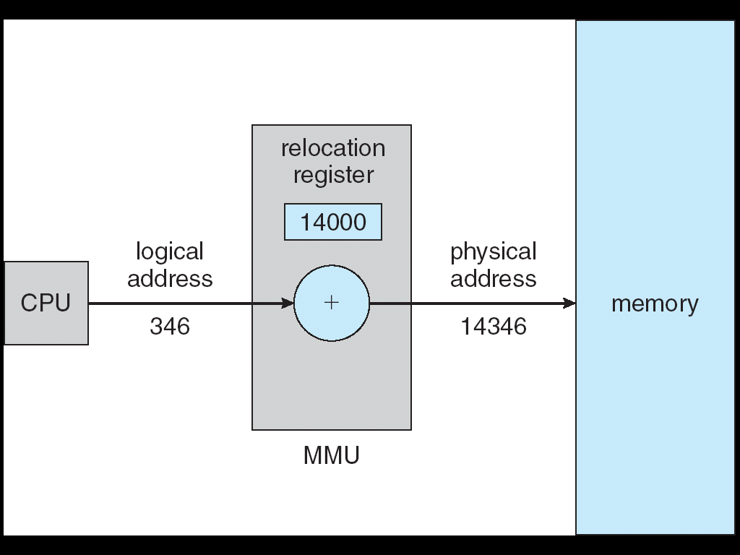
Dynamic relocation using a relocation register

Slide 11
Dynamic Loading
Routine is not loaded until it is called
Better memory-space utilization; unused routine is never loaded
Useful when large amounts of code are needed to handle infrequently occurring cases
No special support from the operating system is required implemented through program design

Slide 12
Dynamic Linking
Linking postponed until execution time
Small piece of code, stub, used to locate the appropriate memory-resident library routine
Stub replaces itself with the address of the routine, and executes the routine
Operating system needed to check if routine is in processes’ memory address
Dynamic linking is particularly useful for libraries
System also known as shared libraries

Slide 13
Swapping
A process can be swapped temporarily out of memory to a backing store, and then brought back into memory for continued execution
Backing store – fast disk large enough to accommodate copies of all memory images for all users; must provide direct access to these memory images
Roll out, roll in – swapping variant used for priority-based scheduling algorithms; lower-priority process is swapped out so higher-priority process can be loaded and executed
Major part of swap time is transfer time; total transfer time is directly proportional to the amount of memory swapped
Modified versions of swapping are found on many systems (i.e., UNIX, Linux, and Windows)
System maintains a ready queue of ready-to-run processes which have memory images on disk

Slide 14
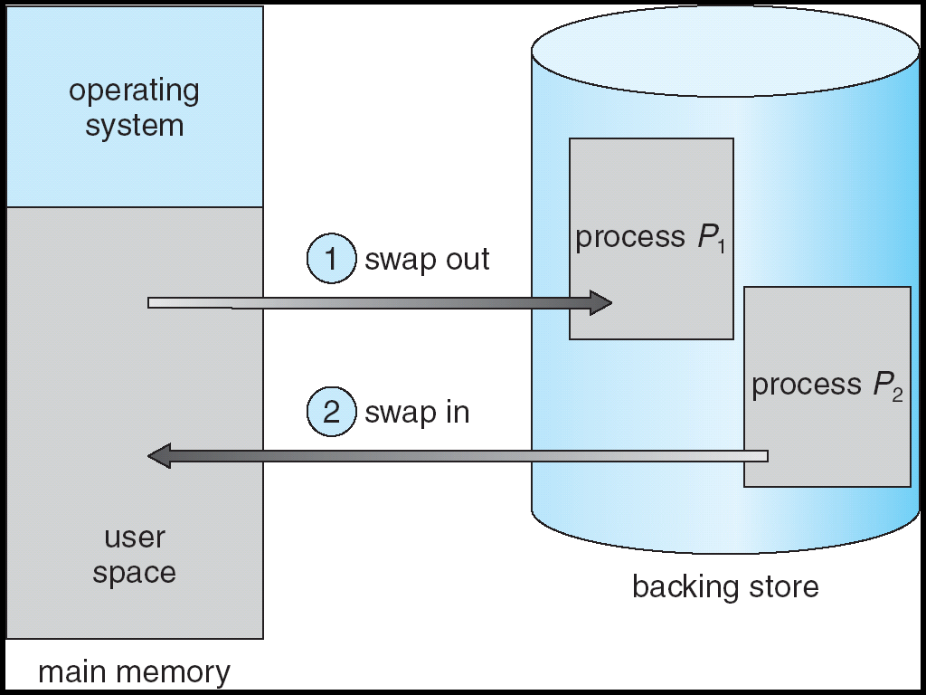
Schematic View of Swapping

Slide 15
Contiguous Allocation
Main memory usually into two partitions:
  Resident operating system, usually held in low memory with interrupt vector
  User processes then held in high memory
Relocation registers used to protect user processes from each other, and from changing operating-system code and data
  Base register contains value of smallest physical address
  Limit register contains range of logical addresses – each logical address must be less than the limit register
  MMU maps logical address dynamically

Slide 16
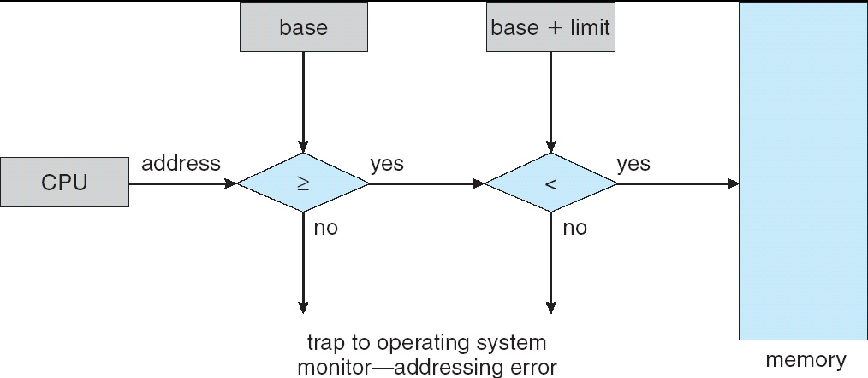
HW address protection with base and limit registers

Slide 17
Contiguous Allocation (Cont.)
Multiple-partition allocation
  Hole – block of available memory; holes of various size are scattered throughout memory
  When a process arrives, it is allocated memory from a hole large enough to accommodate it
  Operating system maintains information about:
  a) allocated partitions b) free partitions (hole)
OS
OS
OS
OS
process 5
process 5
process 5
process 5
process 9
process 9
process 8
process 10
process 2
process 2
process 2
process 2

Slide 18
Dynamic Storage-Allocation Problem
How to satisfy a request of size n from a list of free holes
First-fit: Allocate the first hole that is big enough
Best-fit: Allocate the smallest hole that is big enough; must search entire list, unless ordered by size
  Produces the smallest leftover hole
Worst-fit: Allocate the largest hole; must also search entire list
  Produces the largest leftover hole
First-fit and best-fit better than worst-fit in terms of speed and storage utilization

Slide 19
Given six memory partitions of 300 KB, 600 KB, 350 KB, 200 KB, 750 KB, and 125 KB (in order), how would the first-fit, best-fit, and worst-fit algorithms place processes of size 115 KB, 500 KB, 358 KB, 200 KB, and 375 KB (in order)?
First-Fit: 300 KB (remaining size 185 KB)
Best Fit: 125 KB (remaining size 10 KB)
Worst Fit: 750 KB (remaining size 635 KB)

Slide 20
Fragmentation
External Fragmentation – total memory space exists to satisfy a request, but it is not contiguous
Internal Fragmentation – allocated memory may be slightly larger than requested memory; this size difference is memory internal to a partition, but not being used
Reduce external fragmentation by compaction
  Shuffle memory contents to place all free memory together in one large block
  Compaction is possible only if relocation is dynamic, and is done at execution time
  I/O problem
    Latch job in memory while it is involved in I/O
    Do I/O only into OS buffers

Slide 21
Paging
Logical address space of a process can be noncontiguous; process is allocated physical memory whenever the latter is available
Divide physical memory into fixed-sized blocks called frames (size is power of 2, between 512 bytes and 8,192 bytes)
Divide logical memory into blocks of same size called pages
Keep track of all free frames
To run a program of size n pages, need to find n free frames and load program
Set up a page table to translate logical to physical addresses
Internal fragmentation

Slide 22
Address Translation Scheme
Address generated by CPU is divided into:
  Page number (p) – used as an index into a page table which contains base address of each page in physical memory
  Page offset (d) – combined with base address to define the physical memory address that is sent to the memory unit
  For given logical address space 2^{m} and page size 2^{n}
page number
page offset
p
d
m - n
n

Slide 23
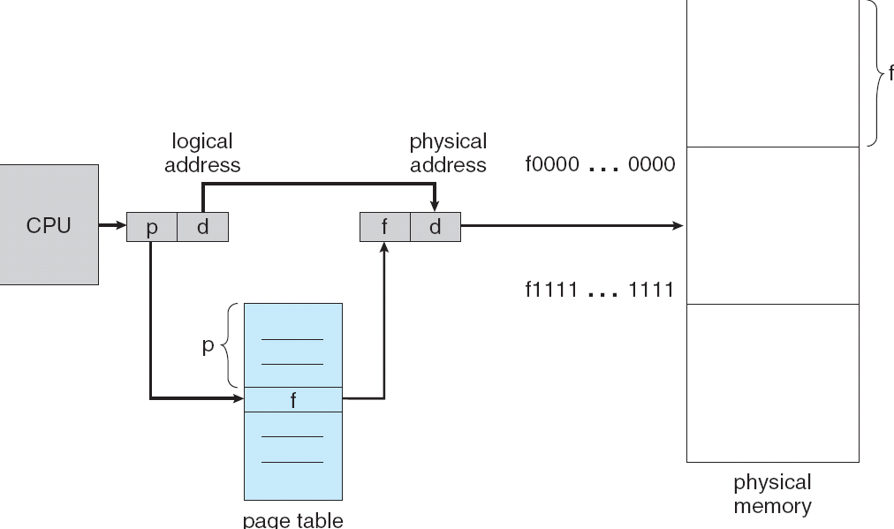
Paging Hardware

Slide 24
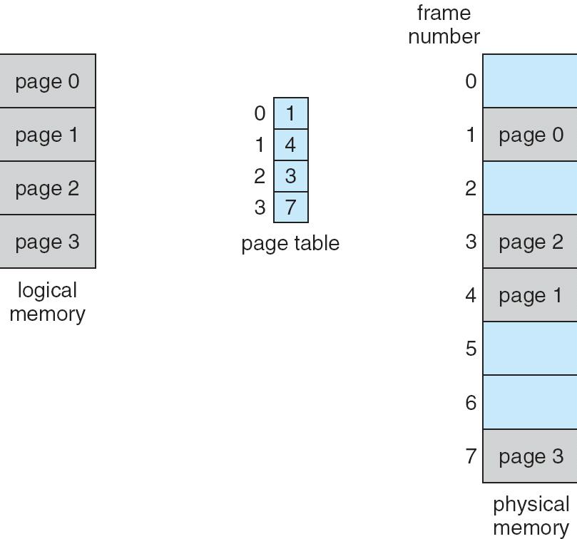
Paging Model of Logical and Physical Memory

Slide 25
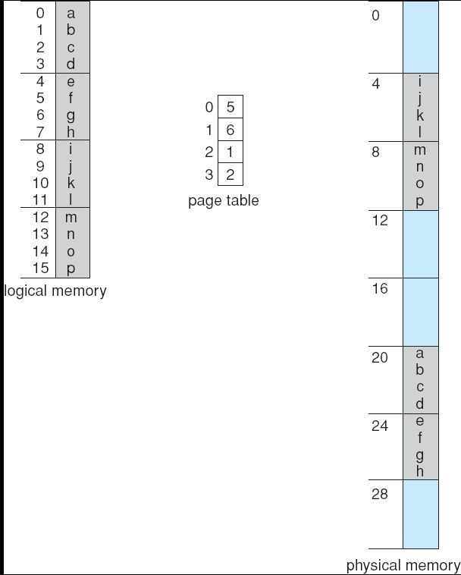
Paging Example
32-byte memory and 4-byte pages

Slide 26
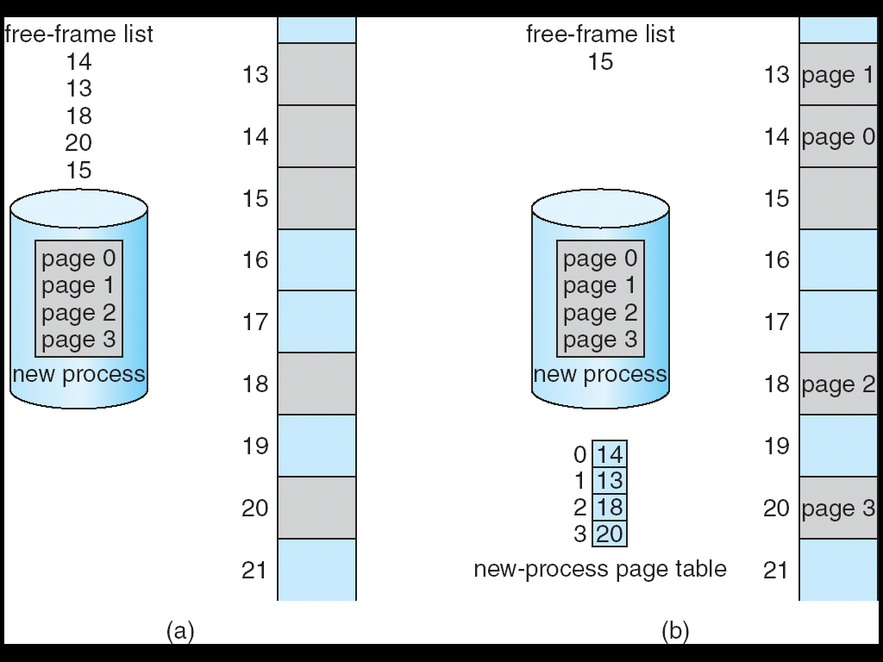
Free Frames
Before allocation
After allocation

Slide 27
Implementation of Page Table
Page table is kept in main memory
Page-table base register (PTBR) points to the page table
Page-table length register (PRLR) indicates size of the page table
In this scheme every data/instruction access requires two memory accesses. One for the page table and one for the data/instruction.
The two memory access problem can be solved by the use of a special fast-lookup hardware cache called associative memory or translation look-aside buffers (TLBs)
Some TLBs store address-space identifiers (ASIDs) in each TLB entry – uniquely identifies each process to provide address-space protection for that process

Slide 28
Associative Memory
Associative memory – parallel search
Address translation (p, d)
  If p is in associative register, get frame # out
  Otherwise get frame # from page table in memory
Page #
Frame #

Slide 29
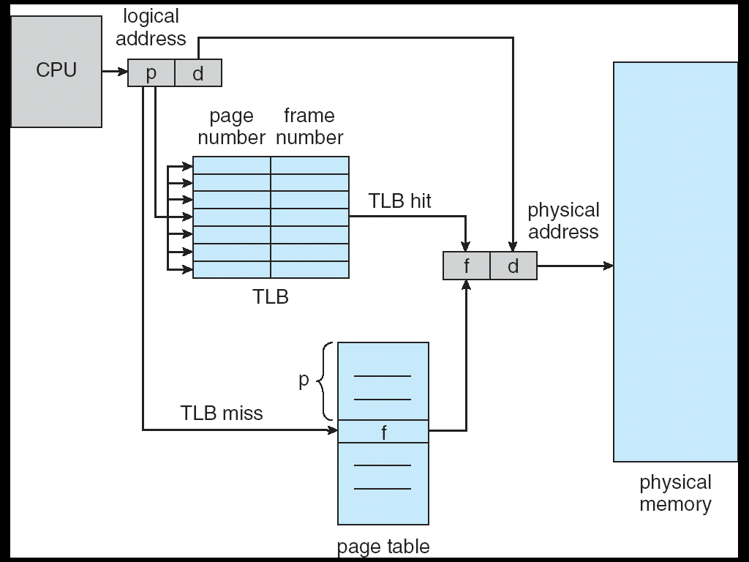
Paging Hardware With TLB

Slide 30
Effective Access Time
Associative Lookup = ε time unit
Assume memory cycle time is 1 microsecond
Hit ratio – percentage of times that a page number is found in the associative registers; ratio related to number of associative registers
Hit ratio = α
Effective Access Time (EAT)
EAT = (1 + ε) α + (2 + ε)(1 – α)
= 2 + ε – α
Higher hit ratio α → lower EAT
Smaller ε → faster associative lookup → lower EAT
EAT is always between 1 + ε (best case) and 2 + ε (worst case)

Slide 31
Consider a logical address space of 64 pages of 1,024 words each, mapped onto a physical memory of 32 frames.
a. How many bits are there in the logical address?
b. How many bits are there in the physical address?
Logical Address=(page number p,offset d)
Page size = 1,024 words = 2¹⁰ words;
Offset requires 10 bits (because 2¹⁰ = 1,024)
Number of pages = 64 = 2⁶
Page number requires 6 bits
Logical address bits=p+d=6+10=16 bits
Physical Address=(frame number f,offset d)
Offset within frame = same as page size = 1,024 words -> 10 bits
Physical memory has 32 frames = 2⁵
Frame number requires 5 bits
Physical address bits=f+d=5+10=15 bits

Slide 32
A program of size 26 KB needs to be loaded into memory using paging. The page size is 8 KB, and the main memory size is 64 KB. Pages are loaded into consecutive physical frames starting from frame 0.
  How many pages are required to load the program?
  Show the page table mapping logical pages to physical frames.
  If the program accesses logical address 20 KB, show how it is translated to a physical address.
  Draw a diagram showing the page table and the memory layout.
Program size = 26 KB
Page size = 8 KB
pages=⌈8 KB / 26 KB​⌉=⌈3.25⌉= 4
So 4 pages are required.
Translate logical address 20 KB → physical address
Page number = floor(20 KB ÷ 8KB) = floor(2.5) = 2
Offset = 20 KB − (2 × 8 KB) = 20 KB − 16 KB = 4 KB
Physical memory:
+--------+--------+--------+--------+--------+--------+--------+--------+
| Frame0 | Frame1 | Frame2 | Frame3 | Frame4 | Frame5 | Frame6 | Frame7 |
| P0 | P1 | P2 | P3 | free | free | free | free |
+--------+--------+--------+--------+--------+--------+--------+--------+
addresses: 0KB 8KB 16KB 24KB 32KB 40KB 48KB 56KB (end 64KB)
Example translation shown:
Logical addr = 20 KB → page 2, offset 4 KB
Page 2 maps → Frame 2 → physical addr = 16 KB + 4 KB = 20 KB
page 0 | frame 0 | 0 - 7KB
page 1 | frame 1 | 8 - 15KB
page 2 | frame 2 | 16-31KB
page 3 | frame 3 | 32-39KB
free | frame 4 | 40-47KB
free | frame 5 | 48-55KB
free | frame 6 | 56-63KB

Slide 33
Memory Protection
Memory protection implemented by associating protection bit with each frame
Valid-invalid bit attached to each entry in the page table:
  “valid” indicates that the associated page is in the process’ logical address space, and is thus a legal page
  “invalid” indicates that the page is not in the process’ logical address space

Slide 34
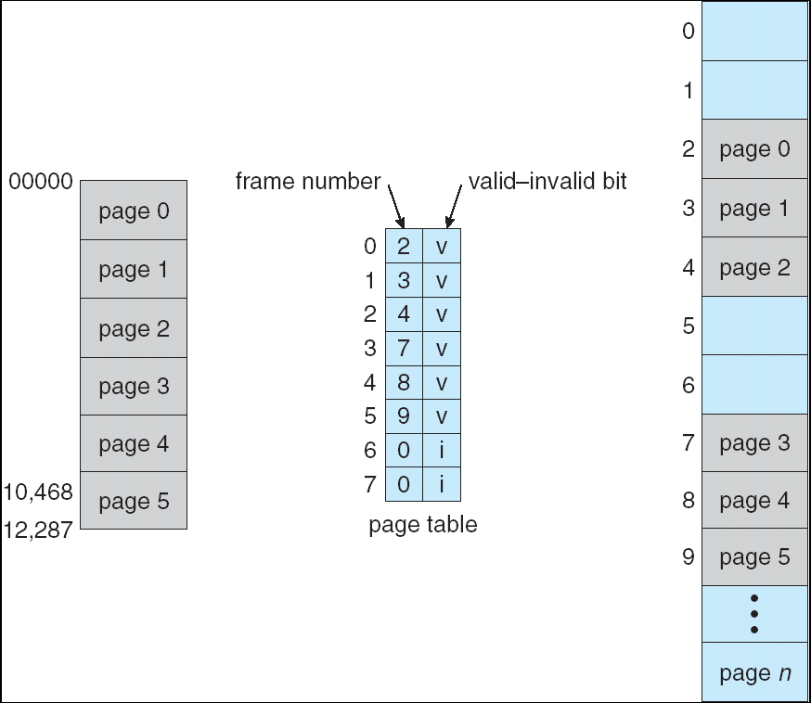
Valid (v) or Invalid (i) Bit In A Page Table

Slide 35
Shared Pages
Shared code
  One copy of read-only (reentrant) code shared among processes (i.e., text editors, compilers, window systems).
  Shared code must appear in same location in the logical address space of all processes
Private code and data
  Each process keeps a separate copy of the code and data
  The pages for the private code and data can appear anywhere in the logical address space

Slide 36
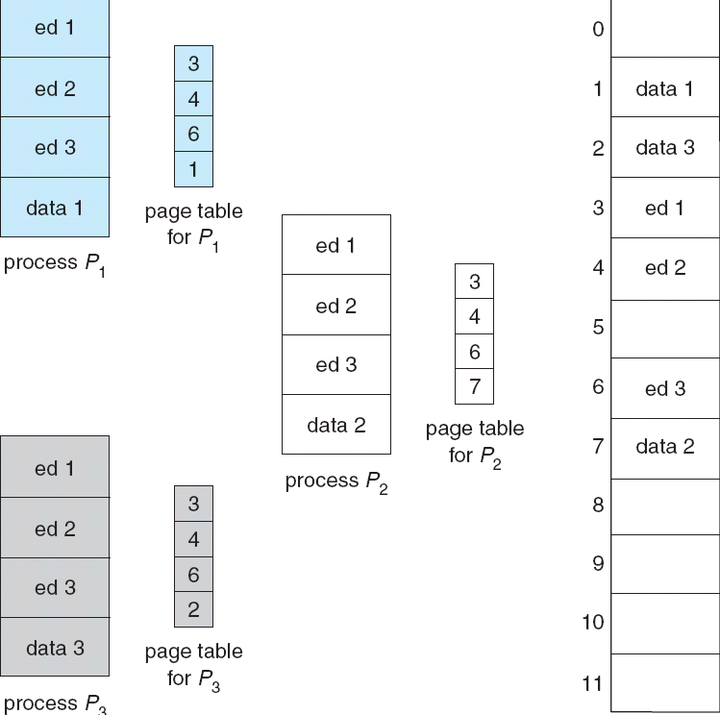
Shared Pages Example

Slide 37
Structure of the Page Table
Hierarchical Paging
Hashed Page Tables
Inverted Page Tables

Slide 38
Hierarchical Page Tables
Break up the logical address space into multiple page tables
A simple technique is a two-level page table

Slide 39
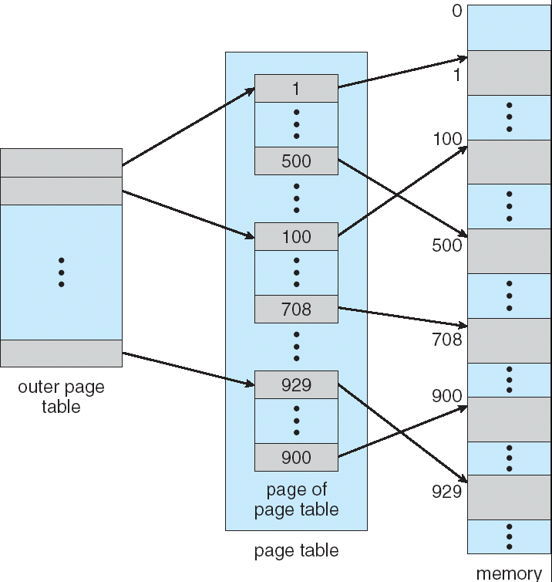
Two-Level Page-Table Scheme

Slide 40
Two-Level Paging Example
A logical address (on 32-bit machine with 1K page size) is divided into:
  a page number consisting of 22 bits
  a page offset consisting of 10 bits
Since the page table is paged, the page number is further divided into:
  a 12-bit page number
  a 10-bit page offset
Thus, a logical address is as follows:
where p_{i} is an index into the outer page table, and p₂ is the displacement within the page of the outer page table
page number
page offset
p_{i}
p₂
d
12
10
10

Slide 41
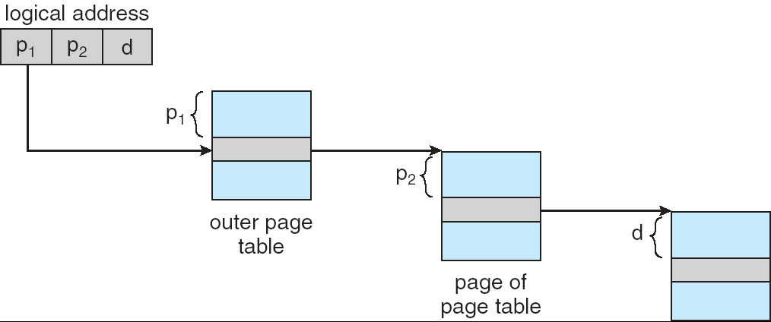
Address-Translation Scheme

Slide 42
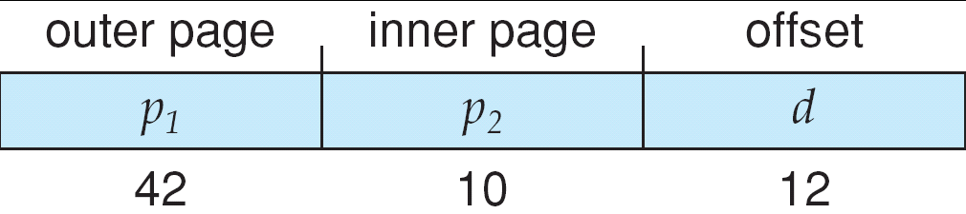
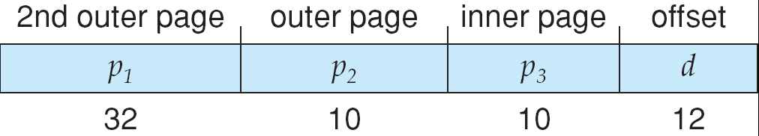
Three-level Paging Scheme

Slide 43
Hashed Page Tables
Common in address spaces > 32 bits
The virtual page number is hashed into a page table. This page table contains a chain of elements hashing to the same location.
Virtual page numbers are compared in this chain searching for a match. If a match is found, the corresponding physical frame is extracted.

Slide 44
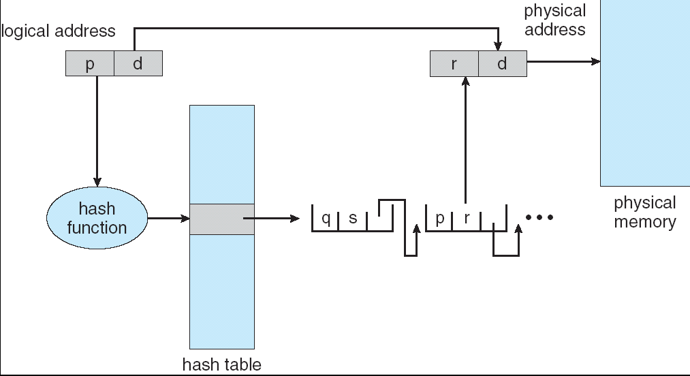
Hashed Page Table

Slide 45
Inverted Page Table
One entry for each real page of memory
Entry consists of the virtual address of the page stored in that real memory location, with information about the process that owns that page
Decreases memory needed to store each page table, but increases time needed to search the table when a page reference occurs
Use hash table to limit the search to one — or at most a few — page-table entries

Slide 46
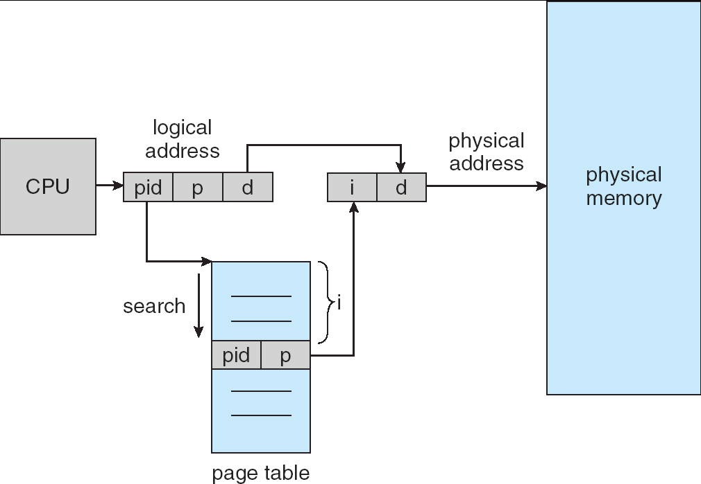
Inverted Page Table Architecture

Slide 47
name | Structure of the page table | Advantages | Disadvantages
Hierarchical (Multi-level) | Page table divided into multiple levels | Reduces memory usage, easy to extend | Slightly slower due to multi-level lookup
Hashed | Page number → hash table | Good for sparse, very large address spaces | Hash collisions, slower lookup than array
Inverted | One entry per physical frame, stores page number + process ID | Memory usage depends on physical memory, not logical | Lookup slower, more hardware/OS support needed

Slide 48
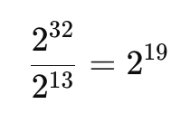
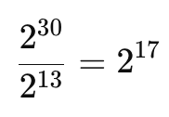
Consider a computer system with a 32-bit logical address and 8-KB page size. The system supports up to 1 GB of physical memory. How many entries are there in each of the following?
a. A conventional, single-level page table
b. An inverted page table
Single-level page table entries
Page size = 8 KB = 2¹³ bytes
Offset bits = 13
Logical address space = 32 bits
So number of pages =
An inverted page table
Physical memory = 1 GB = 2³⁰ bytes
Frame size = 8 KB = 2¹³ bytes
Number of frames =

Slide 49
Segmentation
Memory-management scheme that supports user view of memory
A program is a collection of segments. A segment is a logical unit such as:
main program,
procedure,
function,
method,
object,
local variables, global variables,
common block,
stack,
symbol table, arrays

Slide 50
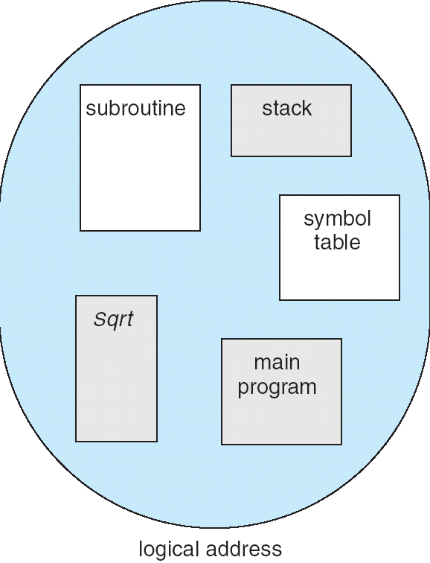
User’s View of a Program

Slide 51
Logical View of Segmentation
1
1
4
2
3
4
2
3
user space
physical memory space

Slide 52
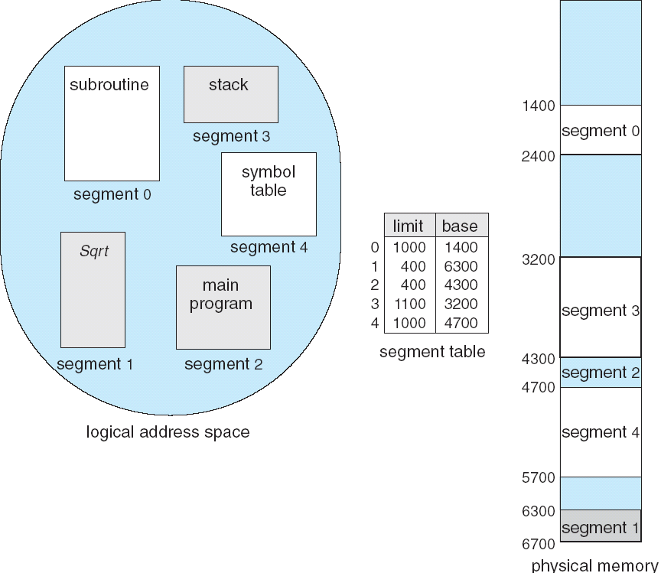
Example of Segmentation

Slide 53
Example: The Intel Pentium
Supports both segmentation and segmentation with paging
CPU generates logical address
  Given to segmentation unit
    Which produces linear addresses
  Linear address given to paging unit
    Which generates physical address in main memory
    Paging units form equivalent of MMU

Slide 54
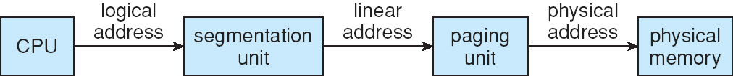
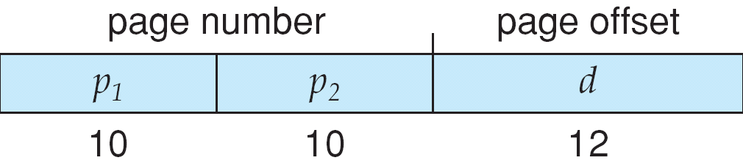
Logical to Physical Address Translation in Pentium

Slide 55
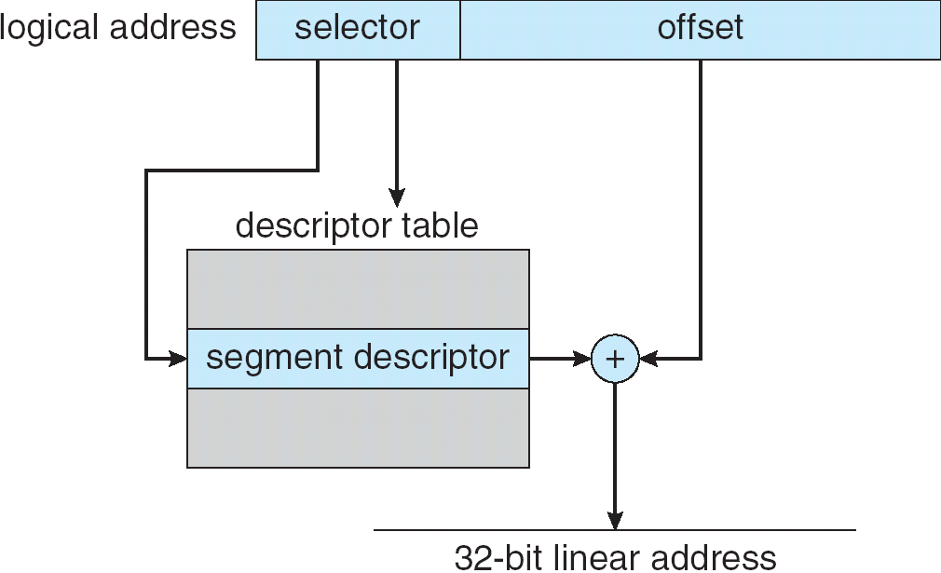
Intel Pentium Segmentation

Slide 56
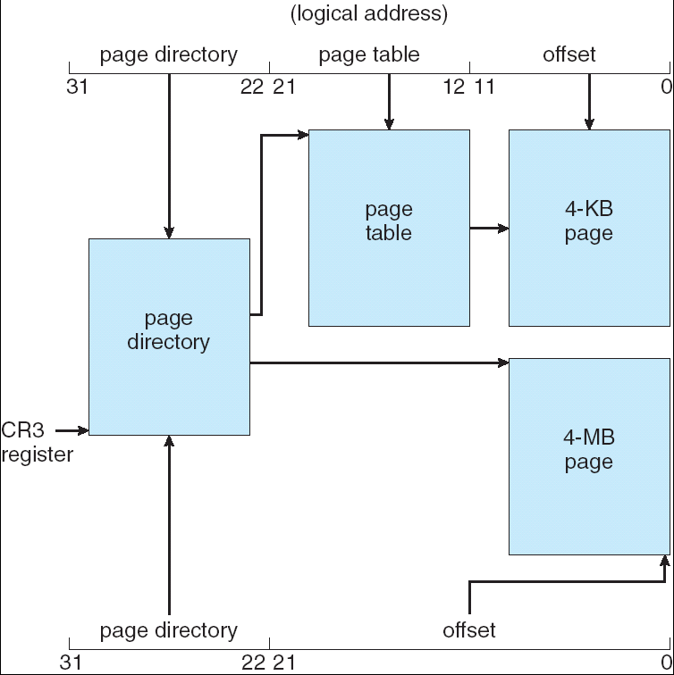
Pentium Paging Architecture

Slide 57
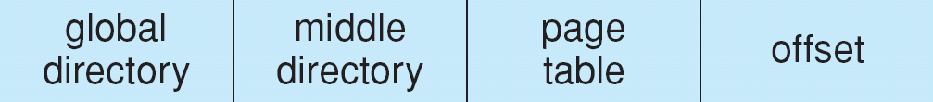
Linear Address in Linux
Broken into four parts:

Slide 58
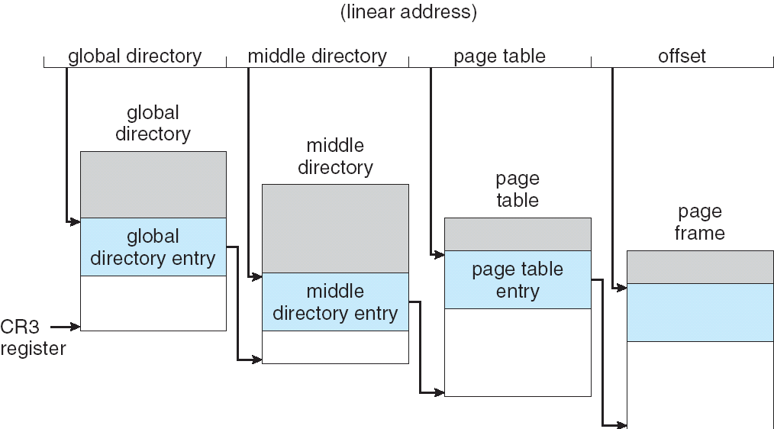
Three-level Paging in Linux

Slide 59
End of Chapter 8

